Slide 1


My research code works correctly on my laptop, but now I need 1,000 laptops to complete my dissertation.
Notes:
How often do you have this problem?
Are your colleagues publishing more often than you? Are they winning best paper awards, while you struggle to analyze data? What do they have that you don't have? Better academic pedigree? Better training? No, often it is just that they have better access to computation, and that's the difference. Is access to computation bringing you down?

Slide 2
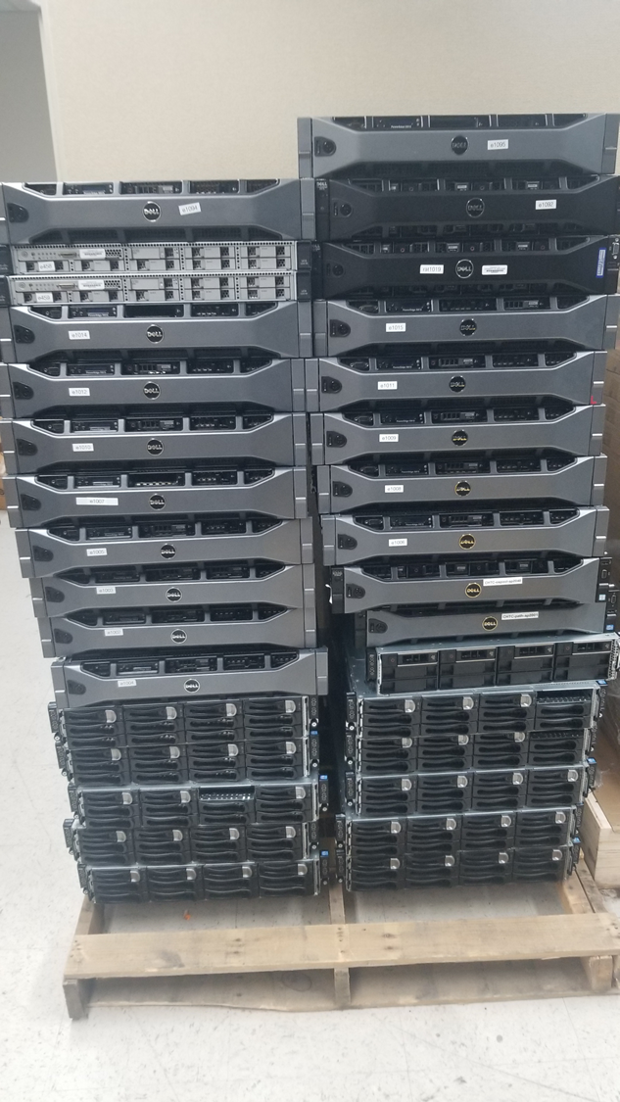

Notes:
How *do* you get access to computation?
You could try to *buy* computers. And struggle through the budget process. And OH! Those sales representatives! You could try to get an allocation at some supercomputing site. But OH, those allocation requests. And the wider impact? Oof. Not to mention worrying about every hour of cpu
How about the cloud? Still need to worry about budget and spending. But now it is opex, not capex. And where are we going to find a cloud computing expert to help me out with the terraform and cloud native this and that
What is a researcher going to do?

Slide 3
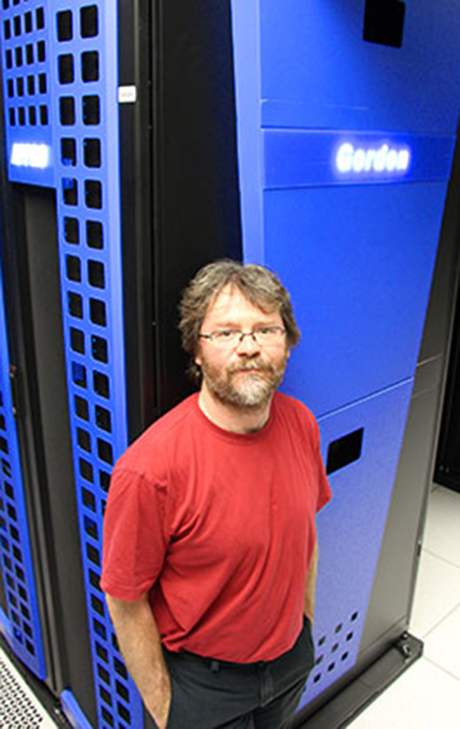

Honest Frank Würthwein's
Used Cluster City
OSPool
Notes:
But not to worry, gentle researchers! Come on down to
Honest Frank Wurthheim's Used Cluster City in the OSPool.
We have GPUs that were only used on Sundays by a little old gamer who only played side-scrolling video games on them. We have Large Memory machines mostly error detecting memory We have Storage systems.
Our machines aren't "used". They aren't even "previously owned". We're just, uh, borrowing them from their current owners.

Slide 4
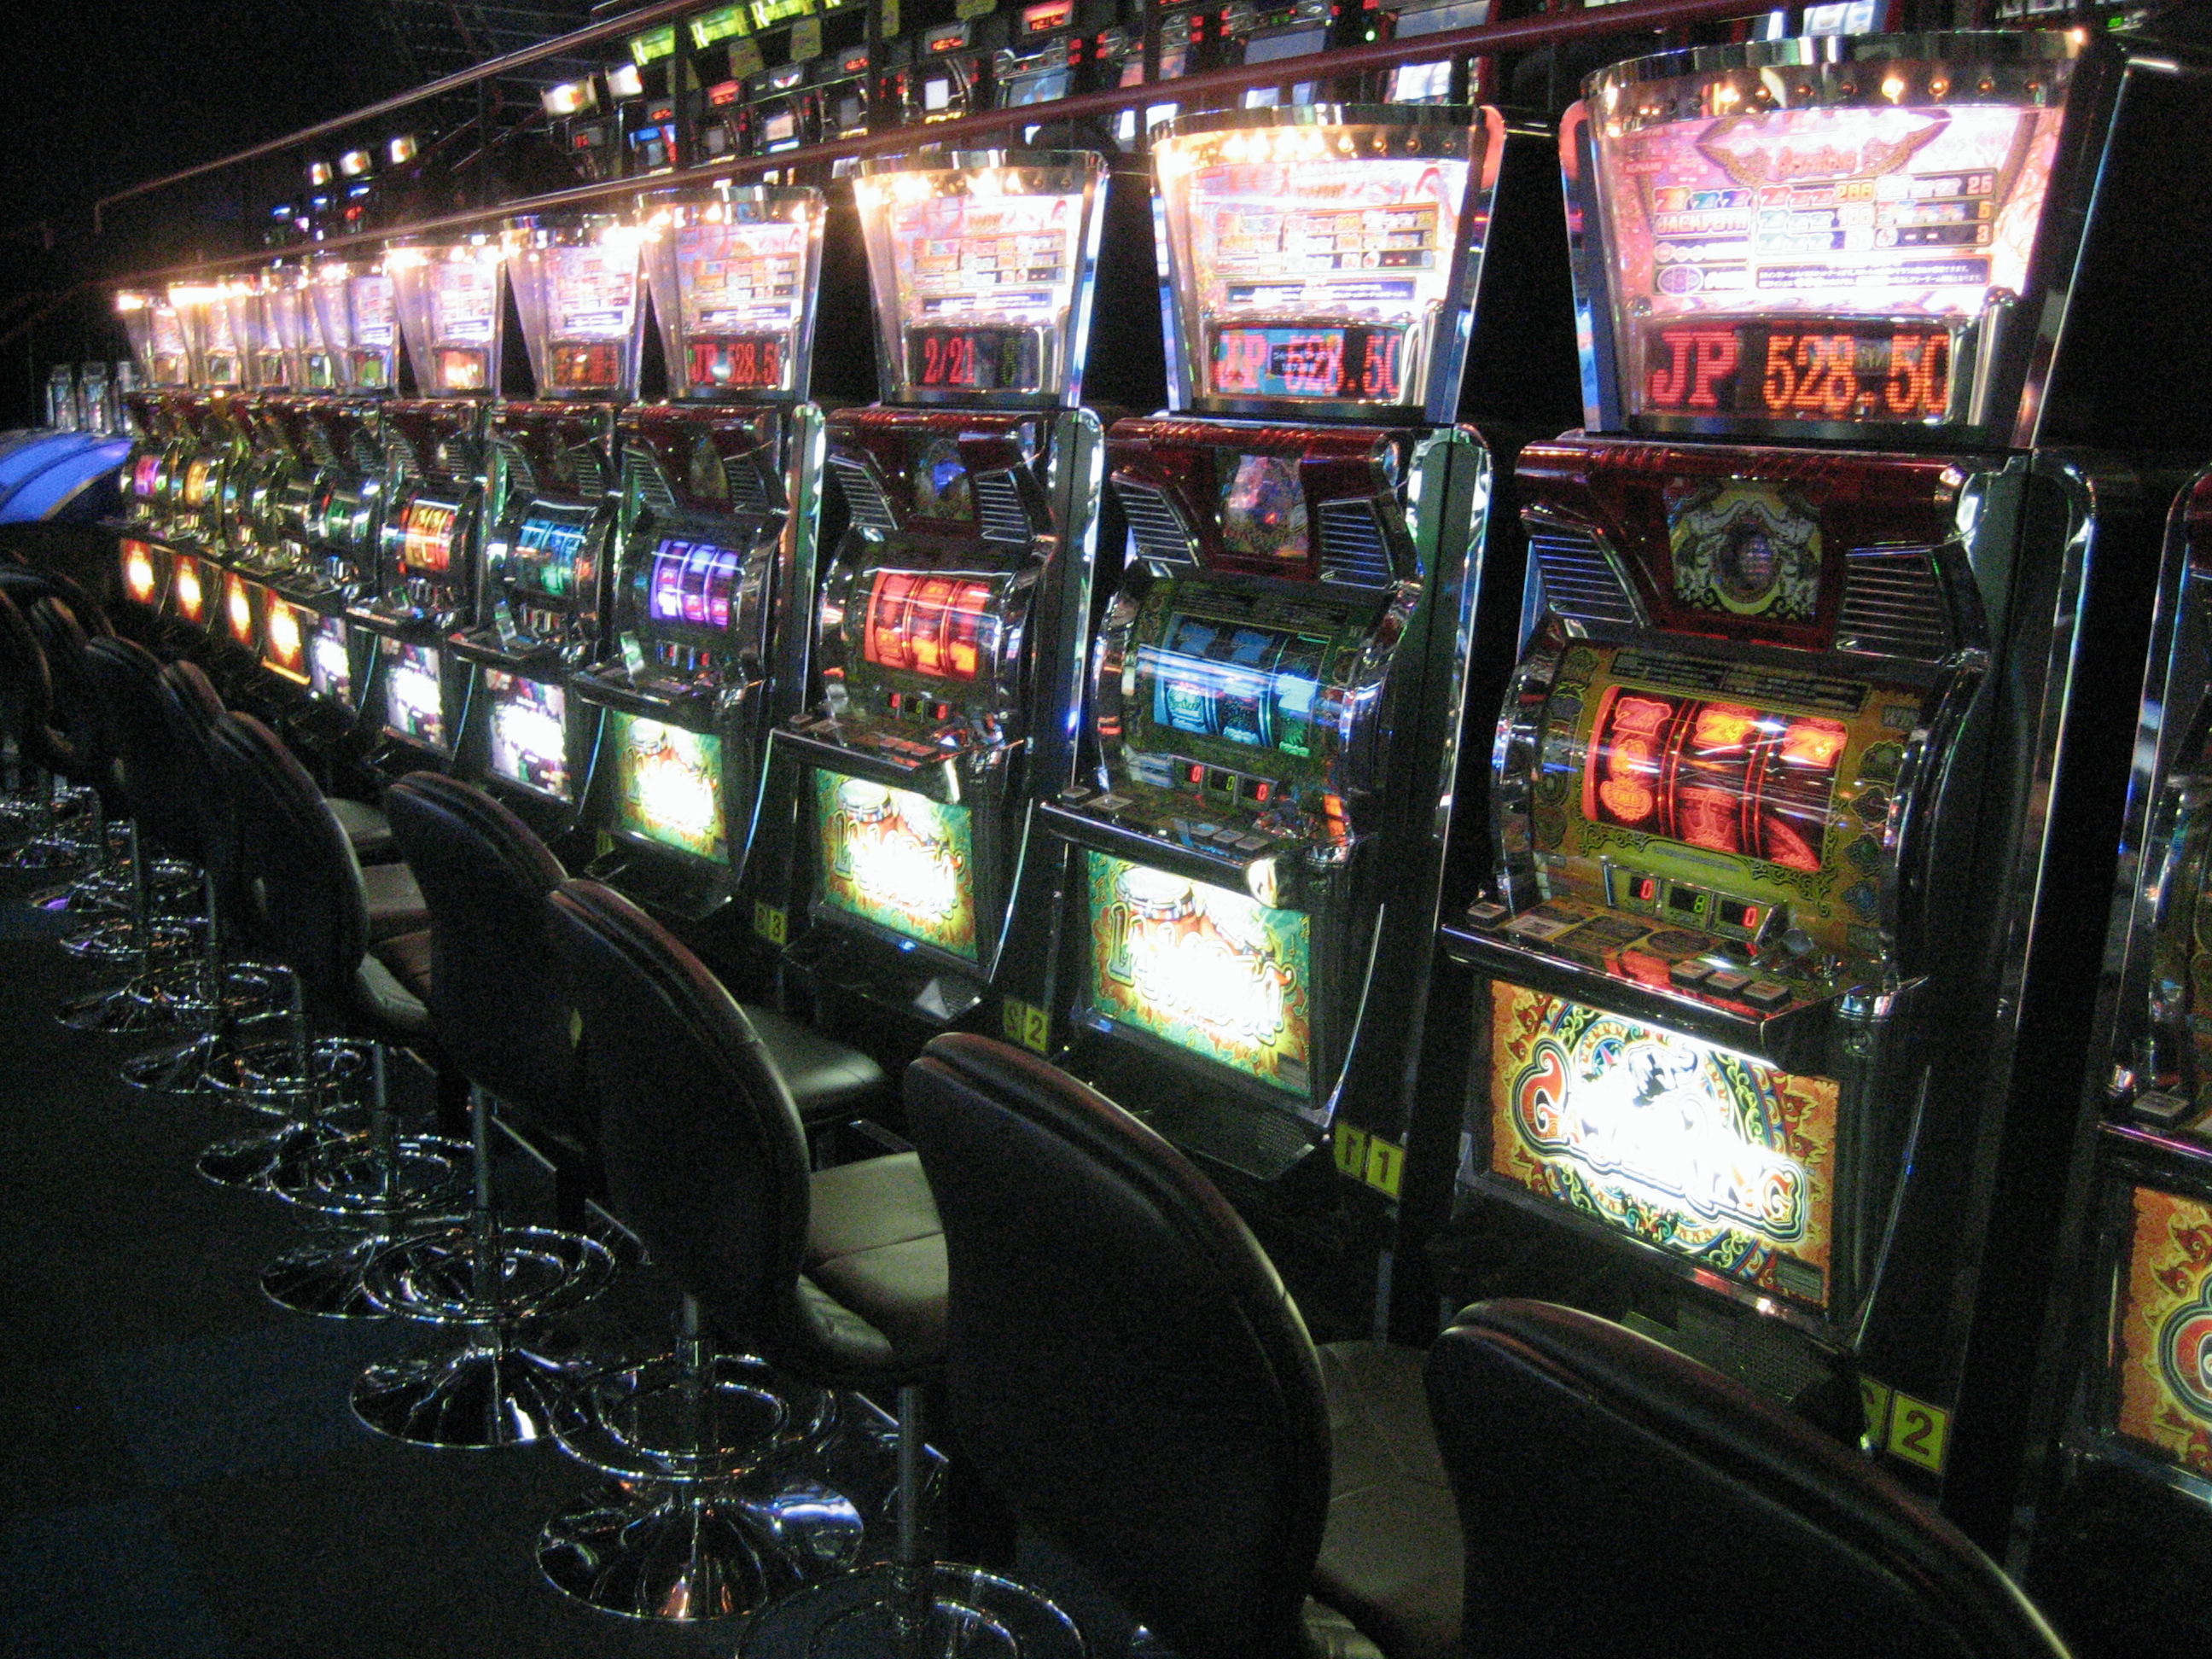
Notes:
And don't worry if financing or writing a grant is a problem for you.
No credit? No Problem
Bad Credit? No Problem
We can mint our own tokens on site to get you started.

Slide 5
Ease of Use
Compute
Power
https://osg-htc.org
Notes:
So, come one down to Honest Frank's Used Cluster city at osg-htc.org
Remember, we're easily located at the Venn Diagram intersection of utility and easy-of-access. Voila!
Ask about this week's Pelican special!

